Slide 1


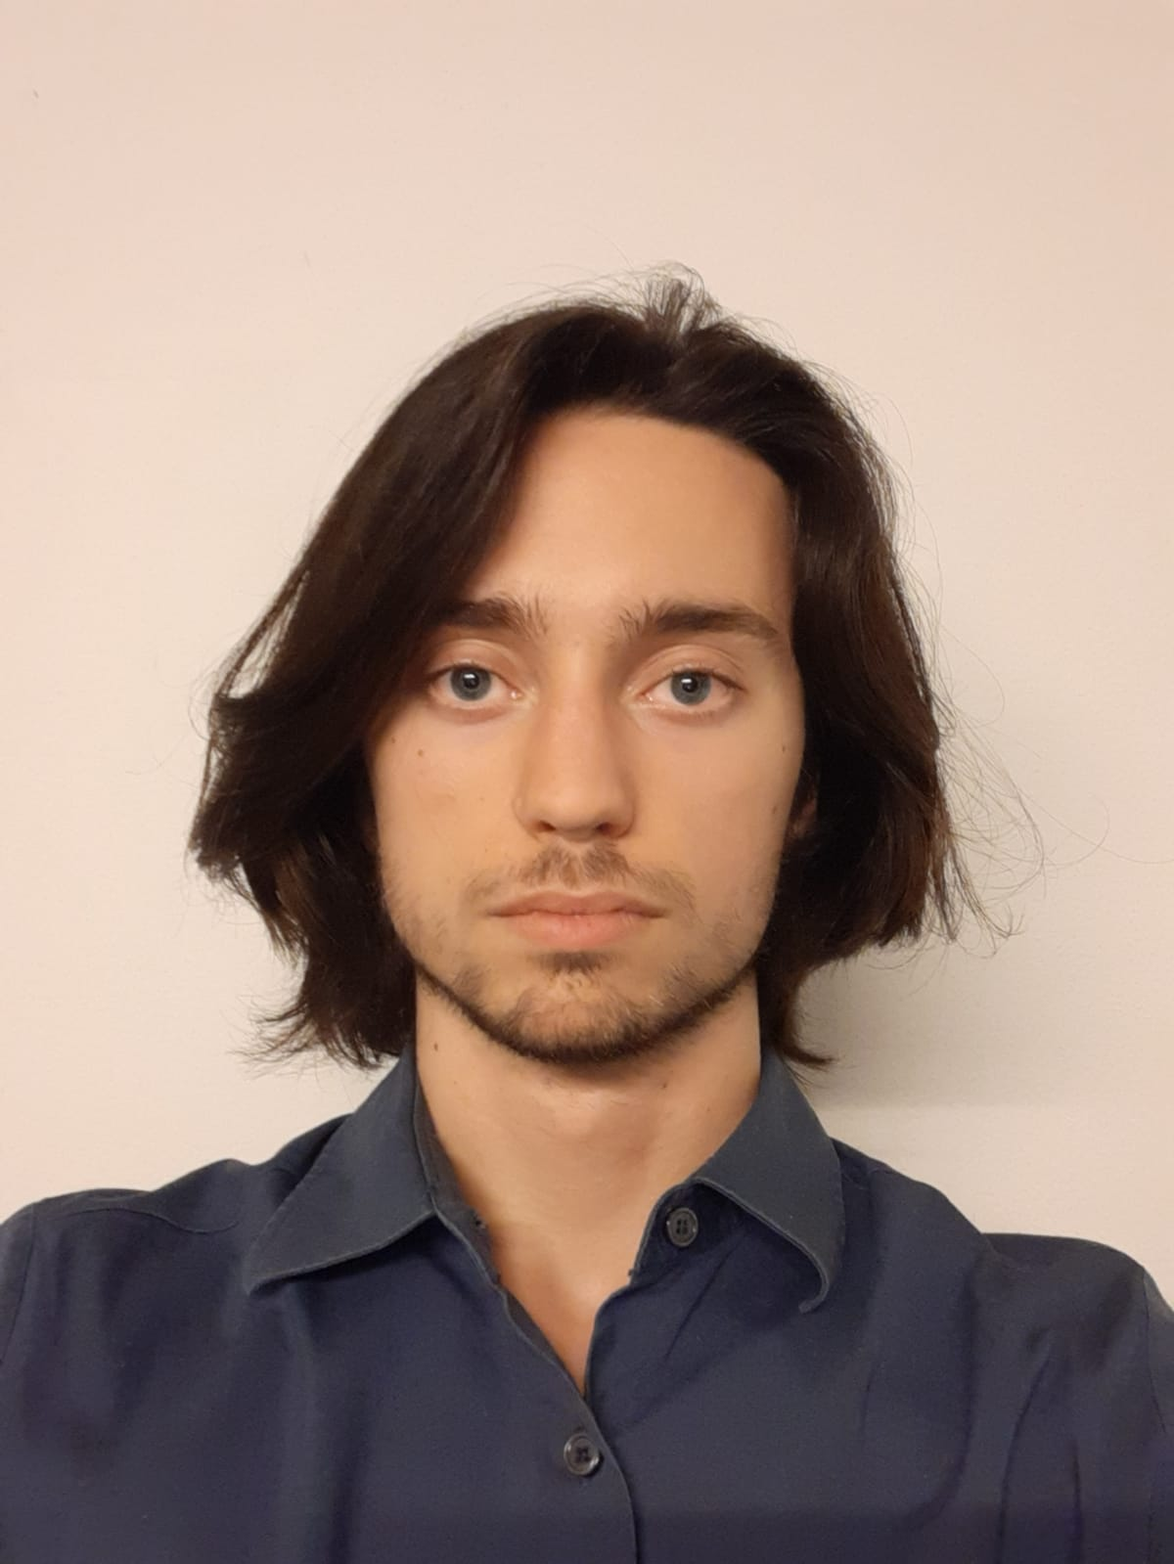


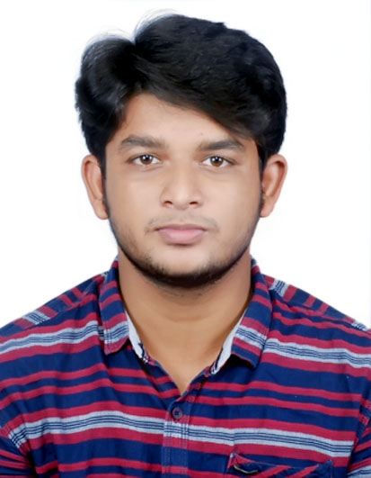
UML modeling of a monitoring system for mood disorders’ patients
Final Presentation Team 08
Marta ALBINI 10681658
Carlotta DE PALO 10699756
Elia Clement NASTASIO 1069104
Mohamed SHALA 10871548
Giovanni VERONELLI 10579308
Mohammed Asif KHAJAMUAINUDEEN 10887712
Medical Informatics – 25/05/2023

Slide 2


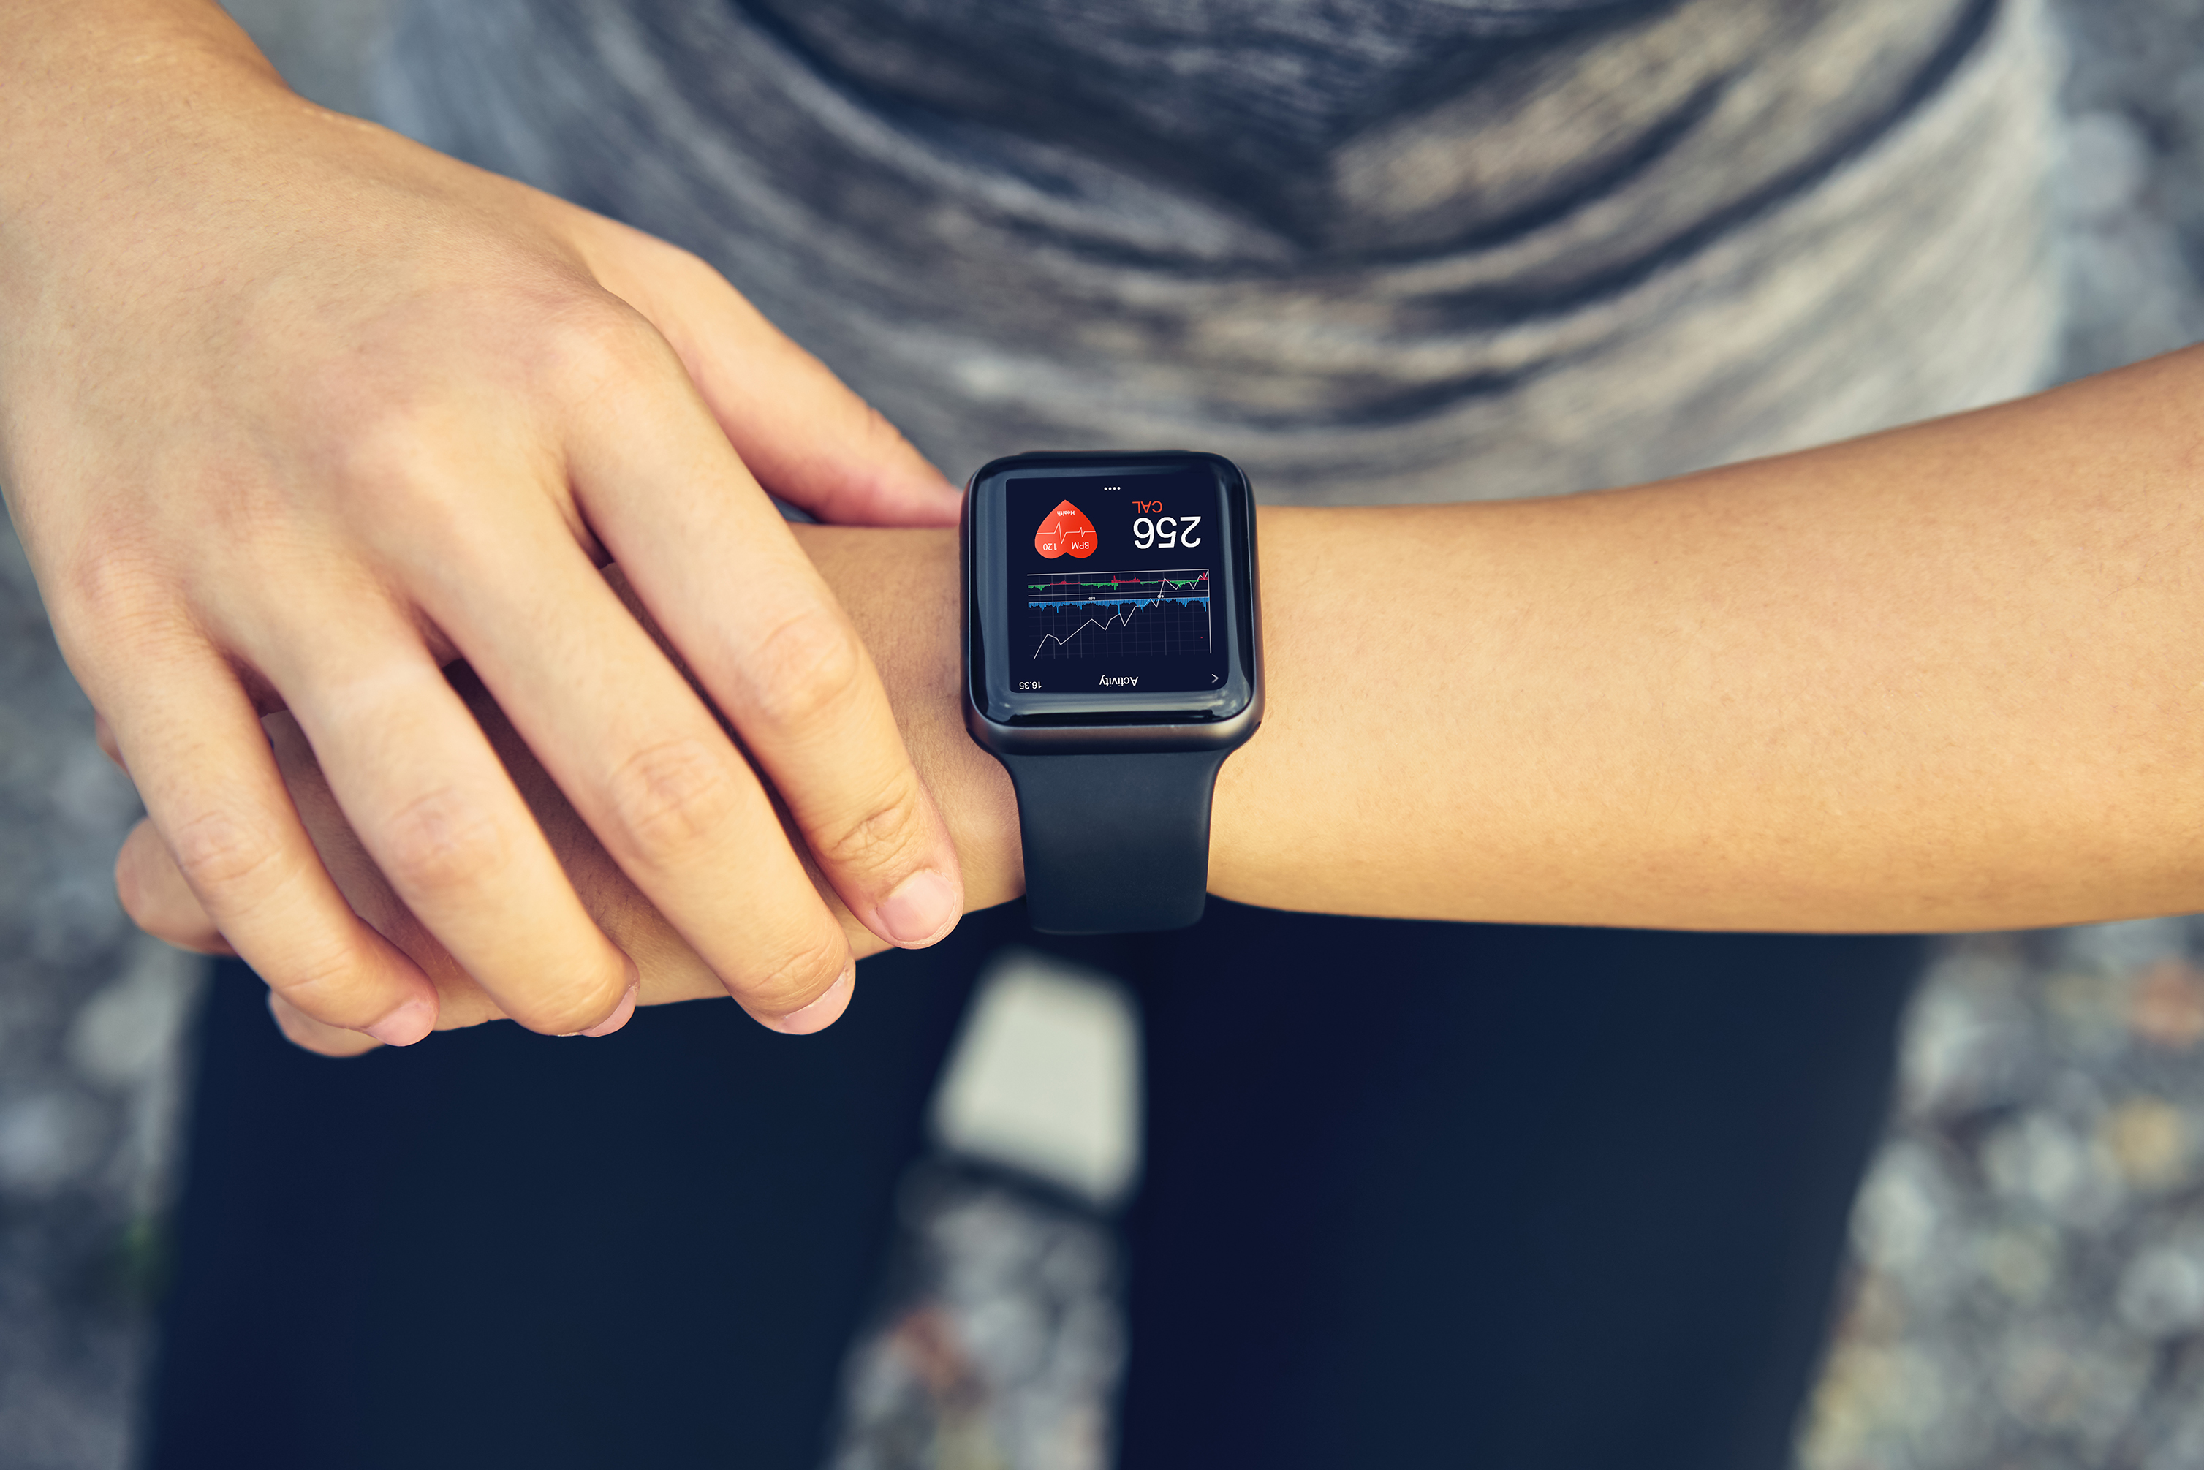


INTRODUCTION
Mobile App for
user interface
Wearable device to
track the Parameters
Monitoring Patient data
With Mobile

Slide 3

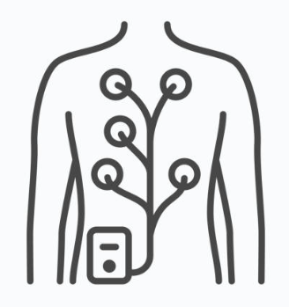
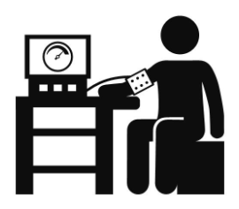
PARAMETERS
At Home
Heart Rate Automatic
Heart Rate Variability Automatic
At Hospital
ECG parameter Manually
Blood Pressure Manually
Height Manually
Weight Manually
BMI Automatic
Activity Level Automatic
Questionnaires Manually
Blood Pressure Manually
Oxygen Saturation Automatic
Height Manually
Weight Manually
Cardiac Auscultation Manually
Medical Report Manually
Blood Exam Manually
Sleep Quality Automatic

Slide 4
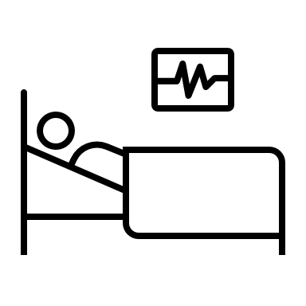



USERS
Users
Patient
Psychiatrist
Caregiver
Technician
Our Software users:

Slide 5

USERS
Patient
1 Psychiatrist
1 Caregiver
Register
Log In/Out
Manage profile
How are you feeling today?
Answer questionnaires
Book appointments with psychiatrist
Check therapy, prescriptions and exams results
Visualize medical data from sensors
Send notes
Visualize notes from doctor and caregiver
Compile diary
Read educational content
Call psychological support number
Contact technical assistance

Slide 6



USERS
Patient
1 Psychiatrist
1 Caregiver
Register
Log In/Out
Manage profile
How are you feeling today?
Answer questionnaires
Book appointments with psychiatrist
Check therapy, prescriptions and exams results
Visualize medical data from sensors
Send notes
Visualize notes from doctor and caregiver
Compile diary
Read educational content
Call psychological support number
Contact technical assistance
Automatic assessment of priority

Slide 7


USERS
Patient
1 Psychiatrist
1 Caregiver
Register
Log In/Out
Manage profile
How are you feeling today?
Answer questionnaires
Book appointments with psychiatrist
Check therapy, prescriptions and exams results
Visualize medical data from sensors
Send notes
Visualize notes from doctor and caregiver
Compile diary
Read educational content
Call psychological support number
Contact technical assistance
Automatic assessment of priority
Enabled only after psychiatrist request
Emergency message to the hospital

Slide 8

USERS
Patient
1 Psychiatrist
1 Caregiver
Register
Log In/Out
Manage profile
How are you feeling today?
Answer questionnaires
Book appointments with psychiatrist
Check therapy, prescriptions and exams results
Visualize medical data from sensors
Send notes
Visualize notes from doctor and caregiver
Compile diary
Read educational content
Call psychological support number
Contact technical assistance
Automatic assessment of priority
Enabled only after psychiatrist request
Emergency message to the hospital
Just to caregiver

Slide 9
USERS
Psychiatrist
Many patients
Many caregivers
Register
Log In/Out
Manage profile
Request code for patient registration
Request appointment to patient
Access patient list and info
Change patient priority
Check patients therapy, prescriptions, medical data, exams, diary
Modify therapy
Add prescriptions
Upload medical data
Propose educational content
Write notes
Read notes from caregiver
Contact technical assistance

Slide 10

USERS
Psychiatrist
Many patients
Many caregivers
Register
Log In/Out
Manage profile
Request code for patient registration
Request appointment to patient
Access patient list and info
Change patient priority
Check patients therapy, prescriptions, medical data, exams, diary
Modify therapy
Add prescriptions
Upload medical data
Propose educational content
Write notes
Read notes from caregiver
Contact technical assistance
Technician approval

Slide 11
USERS
Psychiatrist
Many patients
Many caregivers
Register
Log In/Out
Manage profile
Request code for patient registration
Request appointment to patient
Access patients list and info
Change patient priority
Check patients therapy, prescriptions, medical data, exams, diary
Modify therapy
Add prescriptions
Upload medical data
Propose educational content
Write notes
Read notes from caregiver
Contact technical assistance
Technician approval
Order of priority

Slide 12

USERS
Psychiatrist
Many patients
Many caregivers
Register
Log In/Out
Manage profile
Request code for patient registration
Request appointment to patient
Access patients list and info
Change patient priority
Check patients therapy, prescriptions, medical data, exams, diary
Modify therapy
Add prescriptions
Upload medical data
Propose educational content
Write notes
Read notes from caregiver
Contact technical assistance
Technician approval
Order of priority
Thresholds of normality

Slide 13
USERS
Psychiatrist
Many patients
Many caregivers
Register
Log In/Out
Manage profile
Request code for patient registration
Request appointment to patient
Access patients list and info
Change patient priority
Check patients therapy, prescriptions, medical data, exams, diary
Modify therapy
Add prescriptions
Upload medical data
Propose educational content
Write notes
Read notes from caregiver
Contact technical assistance
Technician approval
Order of priority
Thresholds of normality
Technician approval

Slide 14
USERS
Caregiver
1 Patient
1 Psychiatrist
Register
Log In/Out
Manage profile
Check therapy, prescriptions, exams results, medical data
Send notes
Check notes
Upload medical data
Read educational content
Contact technical assistance

Slide 15

USERS
Caregiver
1 Patient
1 Psychiatrist
Register
Log In/Out
Manage profile
Check therapy, prescriptions, exams results, medical data
Send notes
Check notes
Upload medical data
Read educational content
Contact technical assistance
Intermediary between patient and psychiatrist

Slide 16

USERS
Caregiver
1 Patient
1 Psychiatrist
Register
Log In/Out
Manage profile
Check therapy, prescriptions, exams results, medical data
Send notes
Check notes
Upload medical data
Read educational content
Contact technical assistance
Intermediary between patient and psychiatrist
At home parameters not measured by smartwatch

Slide 17
USERS
Caregiver
1 Patient
1 Psychiatrist
Technician
Many technicians
Register
Log In/Out
Manage profile
Check therapy, prescriptions, exams results, medical data
Send notes
Check notes
Upload medical data
Read educational content
Contact technical assistance
Registrate
Log In/Out
Verify psychiatrist identity for registration
Update software
Verify and upload educational content
Solve technical problems
Intermediary between patient and psychiatrist
At home parameters not measured by smartwatch

Slide 18
USERS
Caregiver
1 Patient
1 Psychiatrist
Technician
Many technicians
Register
Log In/Out
Manage profile
Check therapy, prescriptions, exams results, medical data
Send notes
Check notes
Upload medical data
Read educational content
Contact technical assistance
Registrate
Log In/Out
Verify psychiatrist identity for registration
Update software
Verify and upload educational content
Solve technical problems
Need of approval
Intermediary between patient and psychiatrist
At home parameters not measured by smartwatch

Slide 19

USERS
Caregiver
1 Patient
1 Psychiatrist
Technician
Many technicians
Register
Log In/Out
Manage profile
Check therapy, prescriptions, exams results, medical data
Send notes
Check notes
Upload medical data
Read educational content
Contact technical assistance
Registrate
Log In/Out
Verify psychiatrist identity for registration
Update software
Verify and upload educational content
Solve technical problems
Need of approval
Intermediary between patient and psychiatrist
All technicians can visualize all the technical problems
At home parameters not measured by smartwatch

Slide 20
STRENGTHS
Active role
Quick psychological support
Patient
Easy traceability in case of emergency
NON PROFESSIONAL USERS
Help in following the therapy
Caregiver
Access the patient’s
psychological state
Psychiatrist
More effective therapy plans
PROFESSIONAL USERS
Notes and appointments

Slide 21
LIMITATIONS and FUTURE DEVELOPMENTS
PRIVACY POLICY
EXTERNAL CONNECTIONS
NEW KINDS OF DOCTORS
THERAPY ADHERENCE
GLOBAL STATISTICS
TUTORIAL

Slide 22
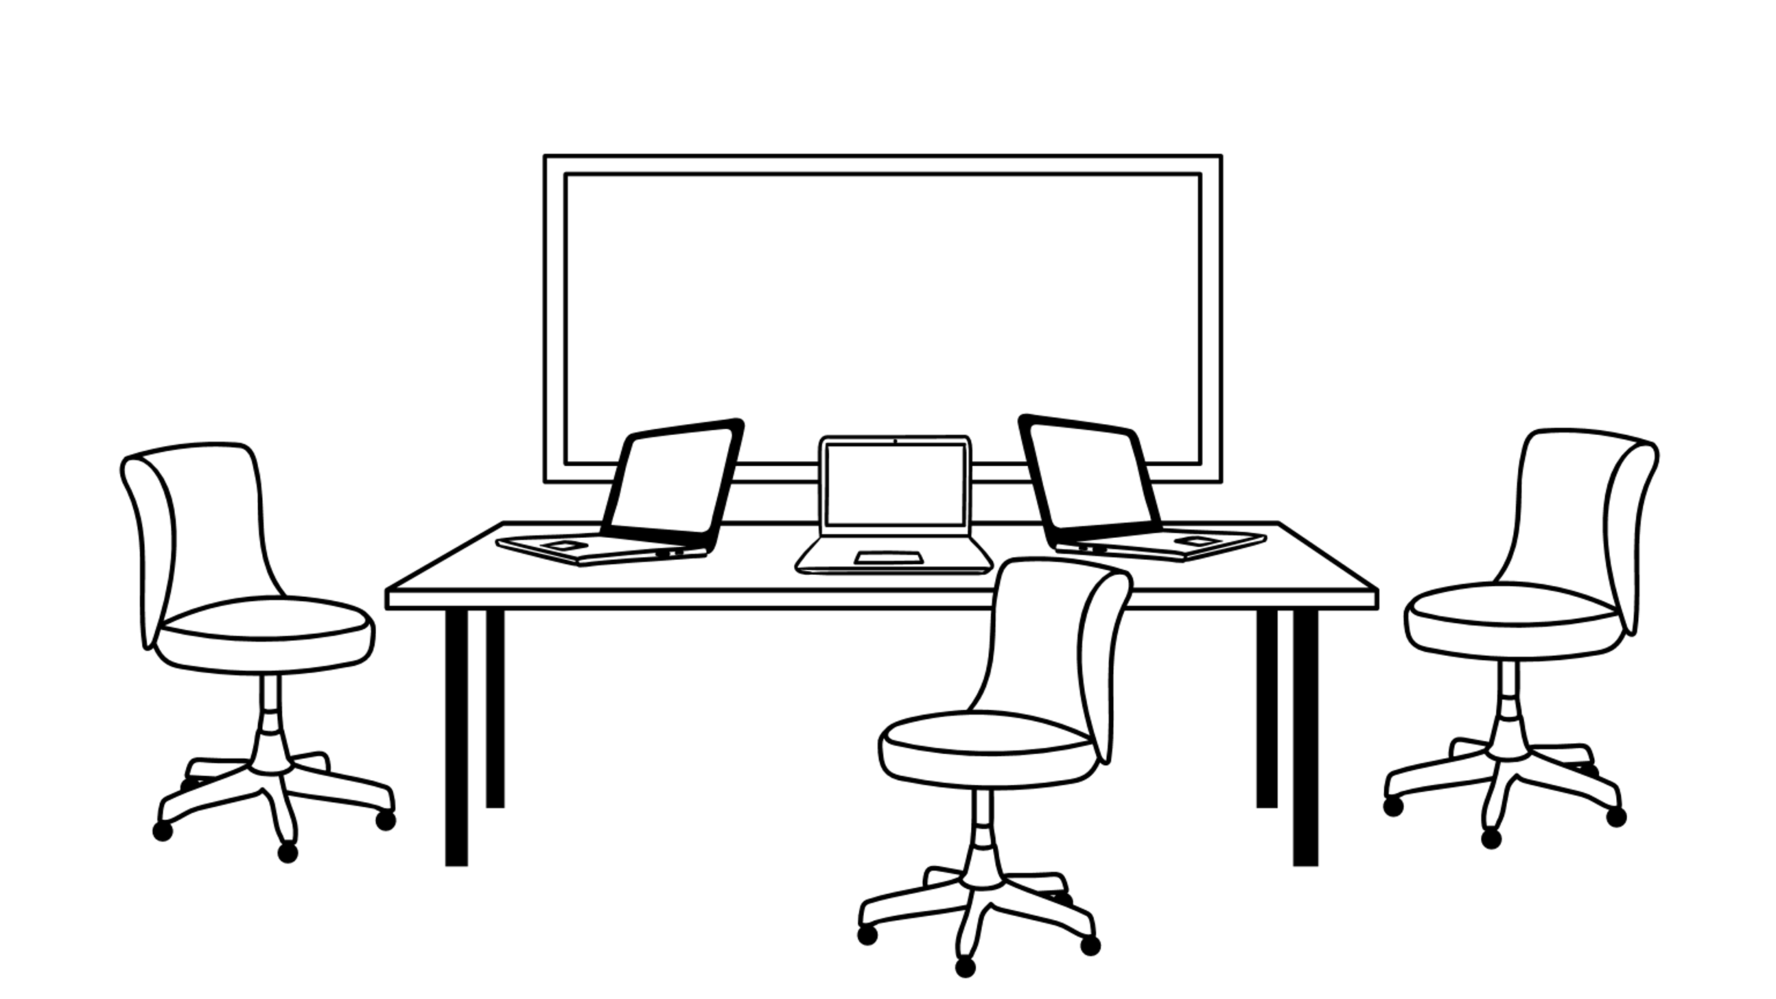

Thanks for the attention!

